Slide 1

🕕 Starter - Algorithm
Kacper needs a program that can count the number of calories he eats throughout the day. The program should:
Ask the user to enter a number of calories they have just eaten
If the user has eaten more than 1000 calories, the program should output “nice food!”
If it the user has eaten more than 2000 calories, it should output “watch out!”
Keep asking for the user to enter calories until they enter 0 calories
After the enters 0 calories, it should finish the program and output the number of calories they have eaten that day

Slide 2

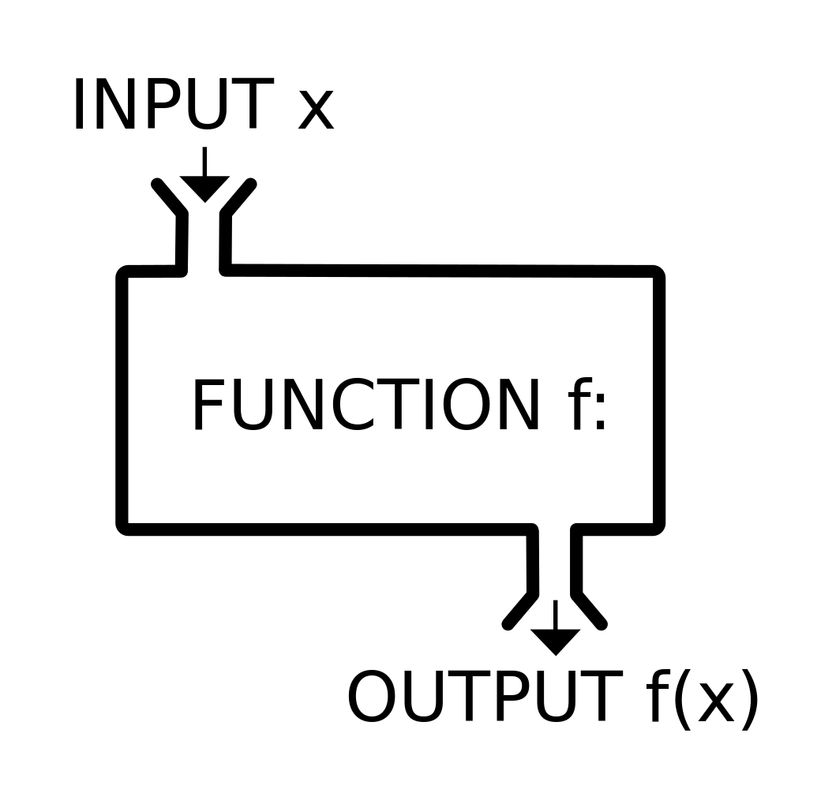


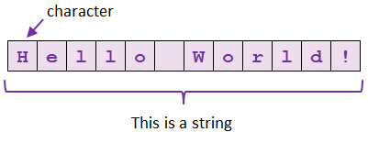
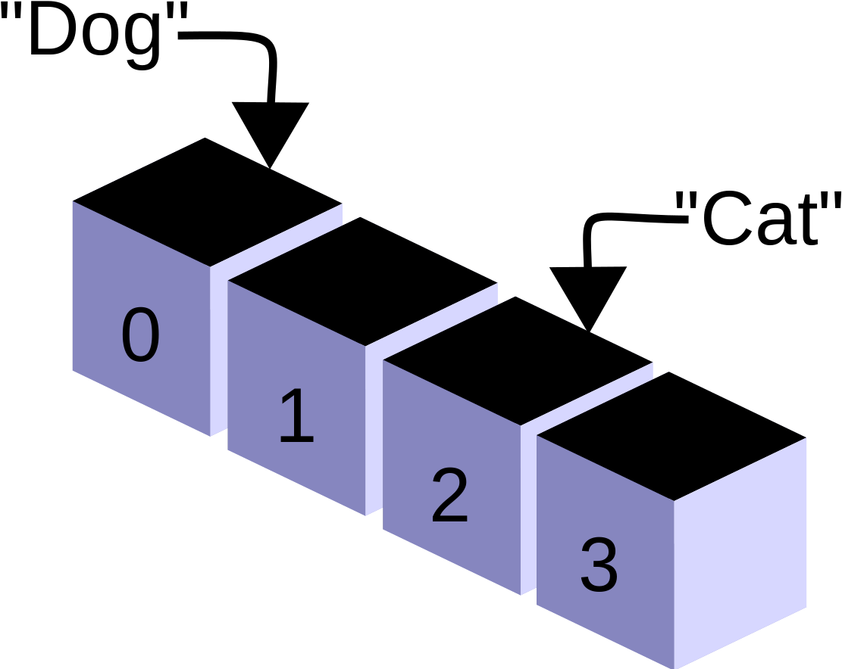


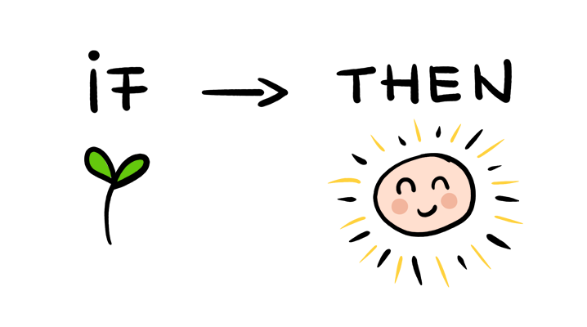
How do I write algorithms by hand?
Y11 - Algorithms
How do I write data to a file?
Practice
What are subprograms and how do I use them?
How do I use arrays?
When do I need to manipulate strings?
What are the different types of iteration?
How do I write an if statement?
Start
When should I use iteration?
How do I get input from a user?

Slide 3

Learning Outcomes
Topic Question:
How do I write algorithms by hand?
Lesson Question:
What are the different types of iteration?

Slide 4
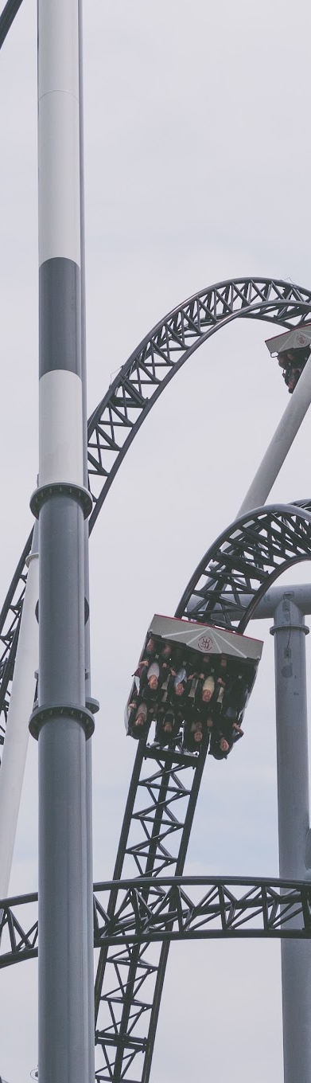

For Loops
What will the following program output?
Why?
Why do we need “i = 0 to 10“, why not just “0 to 10“?
for i = 0 to 10
print( i * 5 )
next i
Notes:
Because i a variable that gets declared at the start of the loop and can be used throughout.

Slide 5
For Loops
We use for loops when we know how many times the code needs to repeat.
The code to write a for loop is:
for i = 0 to 10
print( i * 5 )
next i
Notes:
Because i a variable that gets declared at the start of the loop and can be used throughout.

Slide 6


Algorithm
Write a program that will output “HELLO” five times
Extension:
Each time, it should remove one letter from the word, e.g. “HELLO, ELLO, LLO”
Notes:
Because i a variable that gets declared at the start of the loop and can be used throughout.

Slide 7
Algorithm
Write a program that can output the numbers from 0 to 1000 in order.
extension:
It should print out the total of all the numbers at the end
Notes:
Because i a variable that gets declared at the start of the loop and can be used throughout.

Slide 8
Algorithm
Write a program that can output the 7 times table from 0 * 7 to 100 * 7 i.e. it should output 0, 7, 14, 21, 28 etc.
extension:
It should print out the total of all the numbers at the end
Notes:
Because i a variable that gets declared at the start of the loop and can be used throughout.

Slide 9
Algorithm
Write a program that can output the numbers from what a user enters to 1000 in order. It should print out the total of all the numbers at the end
Extension:
Write a program that will output all the numbers not shown in reverse order.
Notes:
Because i a variable that gets declared at the start of the loop and can be used throughout.

Slide 10
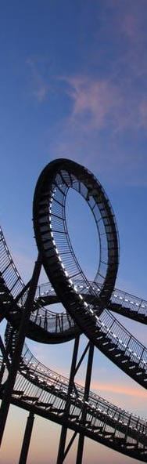
Using Variables in For Loops
We can use variables in for loops to control how many times they are run.
What will the following programs do?
myNum = 7
for i = 0 to myNum
print( i * 2 )
next i
cheese = input("Enter a number")
for i = cheese to 50
print( i )
next i
Notes:
Because i a variable that gets declared at the start of the loop and can be used throughout.

Slide 11
Algorithm
Aisha needs a program that will output the numbers between the number she enters to the number 2000.
Extension:
Change the algorithm so that it keeps a total of all the numbers between the number she enters and the number 2000, and outputs that total at the end.
Notes:
Because i a variable that gets declared at the start of the loop and can be used throughout.

Slide 12

For Loops and Arrays
On your MWB:
What will the following code output to the screen
cheese = ["Stilton", "Cheddar", "Wensleydale"]
print ( cheese[1] )
What about this code?
cheese = ["Stilton", "Cheddar", "Wensleydale"]
for i = 0 to cheese.length - 1
print ( cheese[i] )
next i
Notes:
Because i a variable that gets declared at the start of the loop and can be used throughout.

Slide 13
Algorithm
The array below is provided by a computer program:
myNumbers = [4, 7, 3, 4, 2, 1]
Write a program that will total up all the numbers in the array using a count controlled loop
Extension:
Your program should work for any length array that is supplied.
Instead of an overall total, it should keep track of how many odd and even numbers there are in the array, and output the totals at the end.
Notes:
Because i a variable that gets declared at the start of the loop and can be used throughout.

